Slide 1
PitchPresentation
Roma
by Infinity Eight
Team
Ivan Kravchenko
Samatar Sulieman
Ramin (Roma) Amiri
Anveer Rai
Sebastian Nienajadlo
Ronin Kornelsen
Ethan Williams
Hartion Antraneek

Slide 2
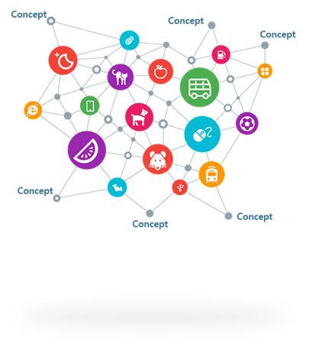
InitialConcept
Sebastian
GENRE: Action, Arcade/Retro
PLATFORM: Windows PC
MONETIZATION MODEL: Free
(Not Free-To-Play)
Free-To-Play (F2P) models have micro-transactions, ads, etc, while simply “Free” games give the full package with no hidden fees/transactions. The only possible way to earn money by making a “Free” game is donations that don’t have to do with gaining anything in-game.

Slide 3
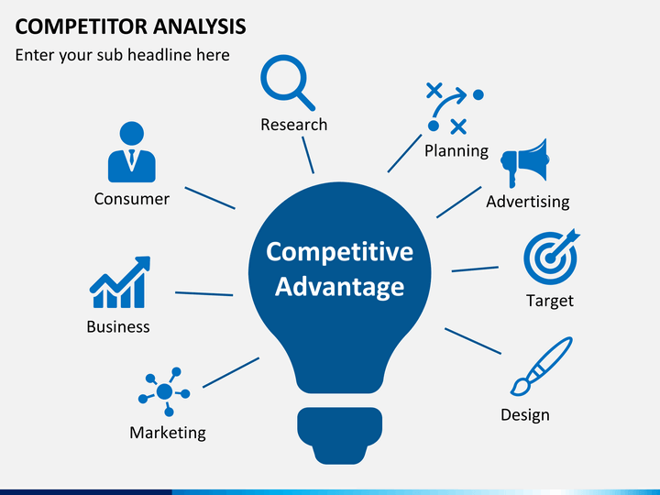
CompetitiveAnalysis Ronin
Evaluating the strategies of Team Strawberry.
PROS
Indie Studio recreating retro titles.
Active in many social media.
Keeping players hyped/anticipated.
CONS
Non-existent wiki.
Lead developer can’t handle criticism.

Slide 4
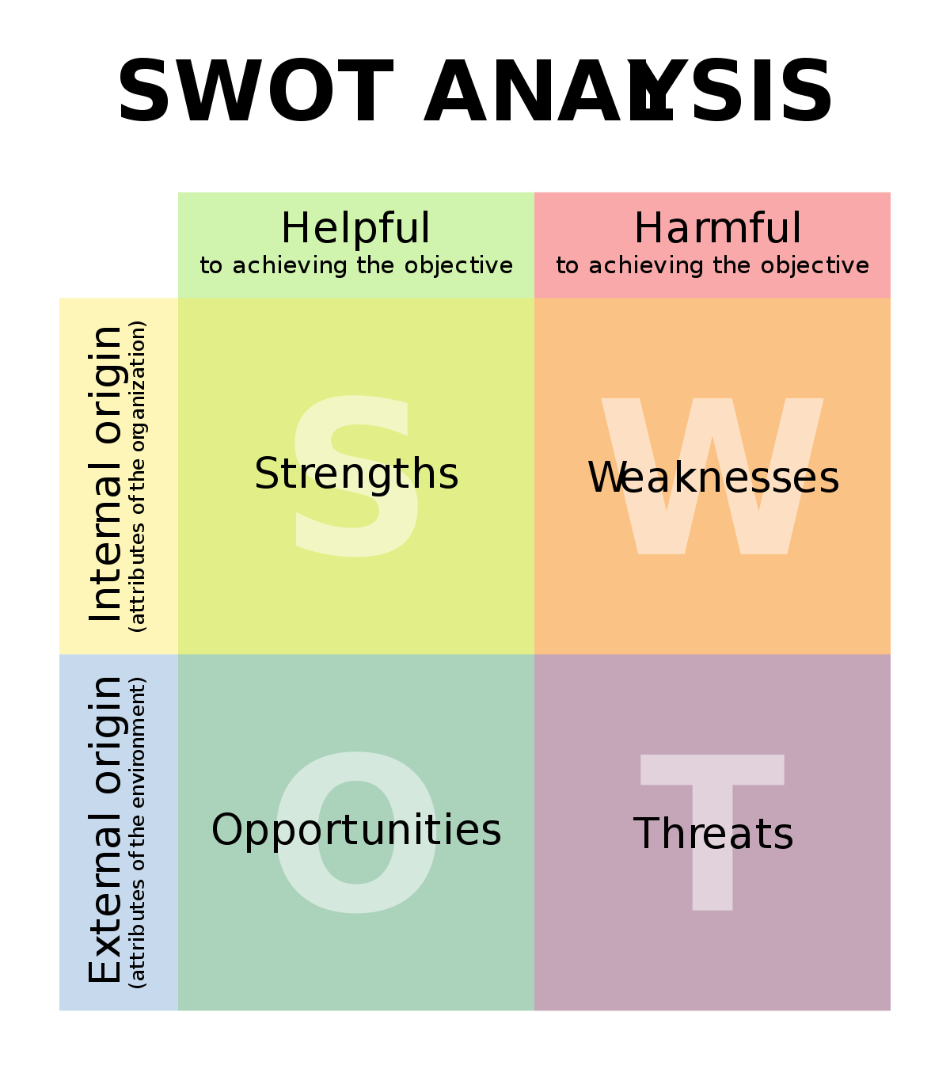
SWOTAnalysis
Roma, Ivan
Threats and opportunities
Primitive gameplay
Nostalgia
Add new mechanics/features to attract interest
Strengths and weaknesses
Simplicity
Resources available online/low budget needed
Low team morale (creating already existing game)

Slide 5
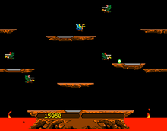
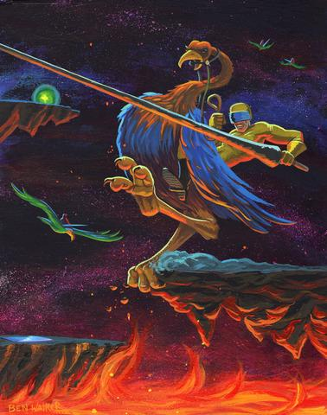
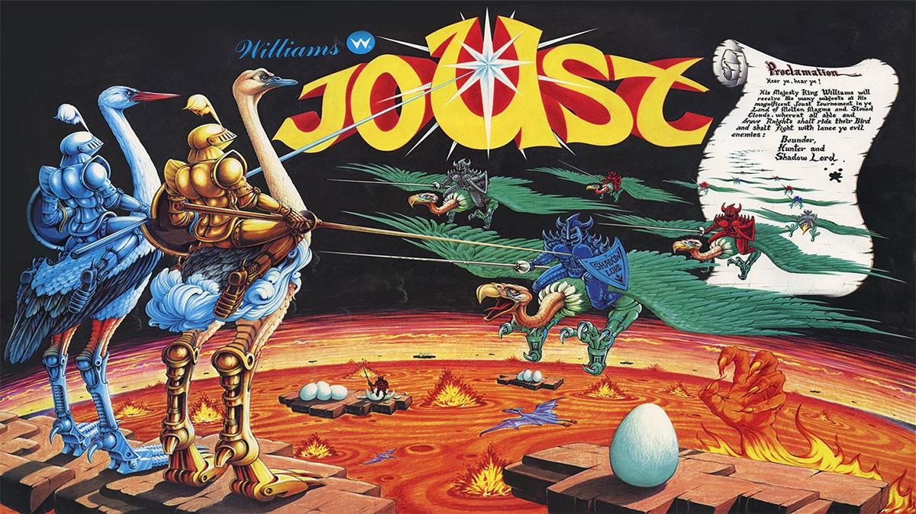
DefinedConcept
Ethan, Anveer
Mission Statement
Game Setting
Gameplay Mechanics
Story Synapsis
Concept Art
Audio
Risk Analysis

Slide 6


GameRequirements
Hartion, Sam
Game Features
Milestone and Deliverables
Evaluate Technology
Define Tools and Pipeline
Documentation
Game Plan
Staffing Plan
Budget

Slide 7

THANKYOU

